Slide 1
Disaster Relief Planning Carlo Miraldi Fairfield Senior High School, Math
RET is funded by the National Science Foundation, grant # EEC 0808696.
Hello, I’m Carlo Miraldi
-I have taught math for seven years
-I’m always interested in learning new methods
Fairfield Senior High School
-Only 10th, 11th, and 12th graders
-2,400 students
CP Precalculus
-1st, 3rd, & 4th bell
-83 seniors and 6 juniors

Slide 2
Disaster Relief Planning Carlo Miraldi Fairfield Senior High School, Math
RET is funded by the National Science Foundation, grant # EEC 0808696.
Big Idea/Essential Question
-Disaster Relief – Accurate and Effective Planning through Precise Calculations.
-How does math contribute to the best possible disaster relief plan?
Unit Structure
CCSS.Math.Content.HSG-SRT.D.11 Understand and apply the Law of Sines and the Law of Cosines to find unknown measurements in right and non-right triangles (e.g., surveying problems, resultant forces).
Objectives
-Discuss & Generate Essential Questions
-Use bearings, Law of Sines, and Law of Cosines
-Create clue cards for “Search & Rescue Mission”
-Implement a “Search & Rescue Mission”
-Design & Present a detailed Disaster Relief Plan

Slide 3
Disaster Relief Planning Carlo Miraldi Fairfield Senior High School, Math
RET is funded by the National Science Foundation, grant # EEC 0808696.
Challenge
Design a detailed Disaster Relief Plan based on an infamous world disaster that uses bearings, Law of Sines, and/or Law of Cosines.
Guiding Questions
-Is it better to fly or ship the supplies?
-How do we prioritize supply distribution?
-What kind of disaster happened?
-How and what kind of help to provide?
-How many people are we helping?
-How do you advertise to build more support?
-What groups can we team up with?

Slide 4
Disaster Relief Planning Carlo Miraldi Fairfield Senior High School, Math
RET is funded by the National Science Foundation, grant # EEC 0808696.
ACS
Real World Applications
-severe thunderstorms, hurricanes, tsunamis, tornadoes, earthquakes, wild fires, and landslides
-might even consider emergency situations such as 9/11, oil spills, ship hijackings, active shooters, missing planes Careers
-coordinators from the military, Red Cross, Matthew 25 Ministries, or product supply distributors
Social Impact
-through camera phones and social networking we are more connected than ever to all of these disasters

Slide 5
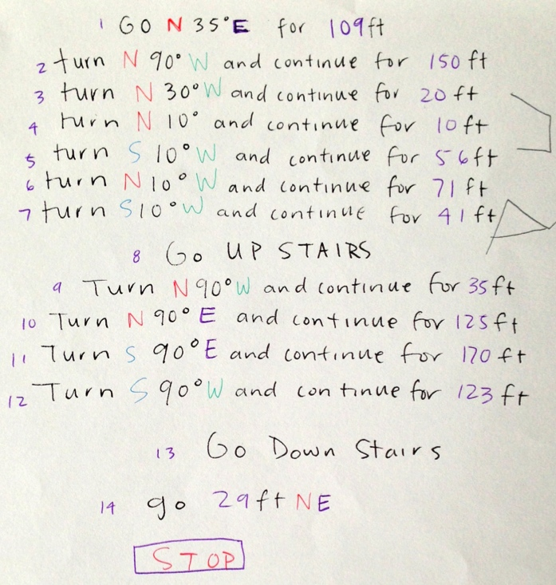
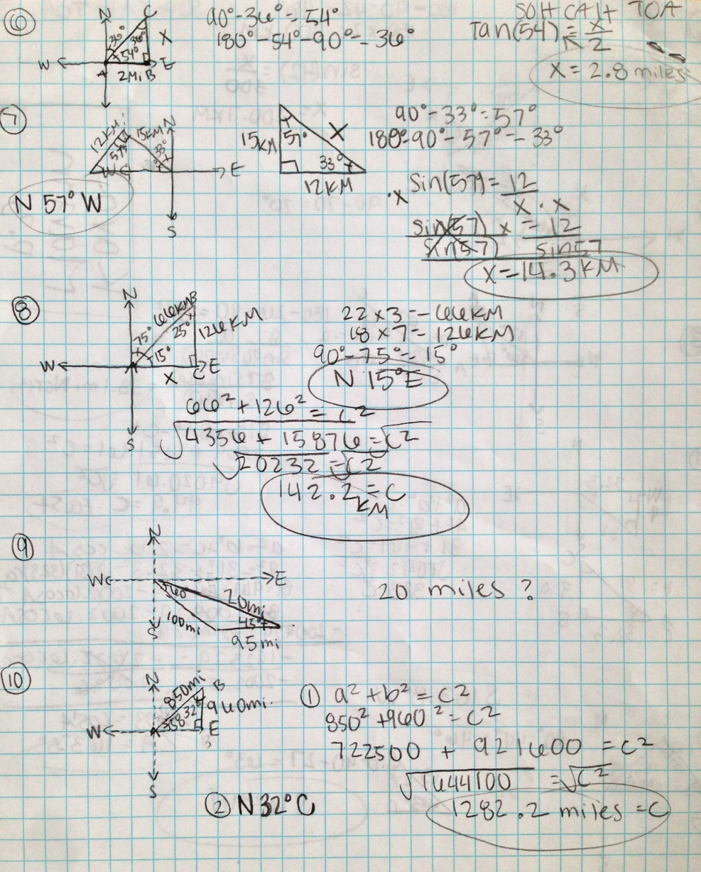
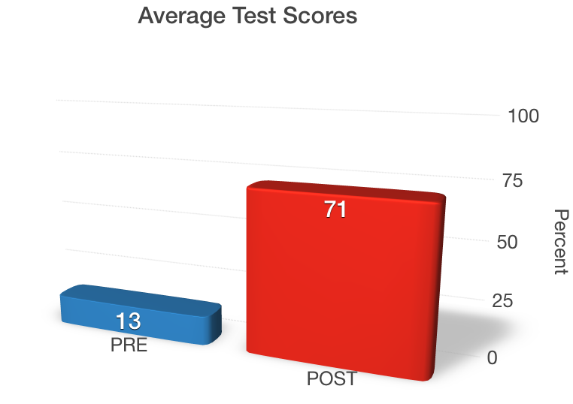
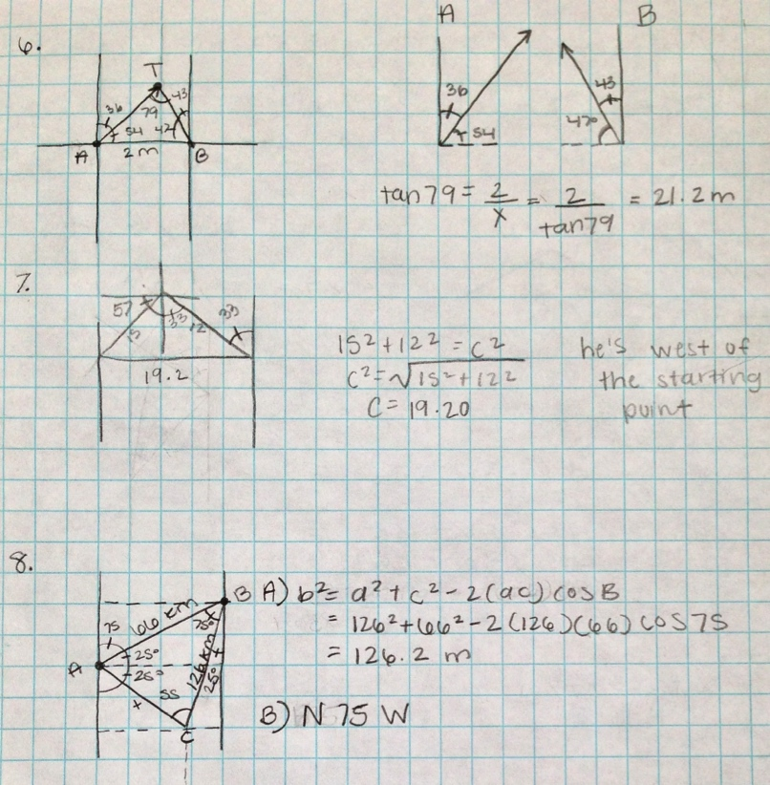
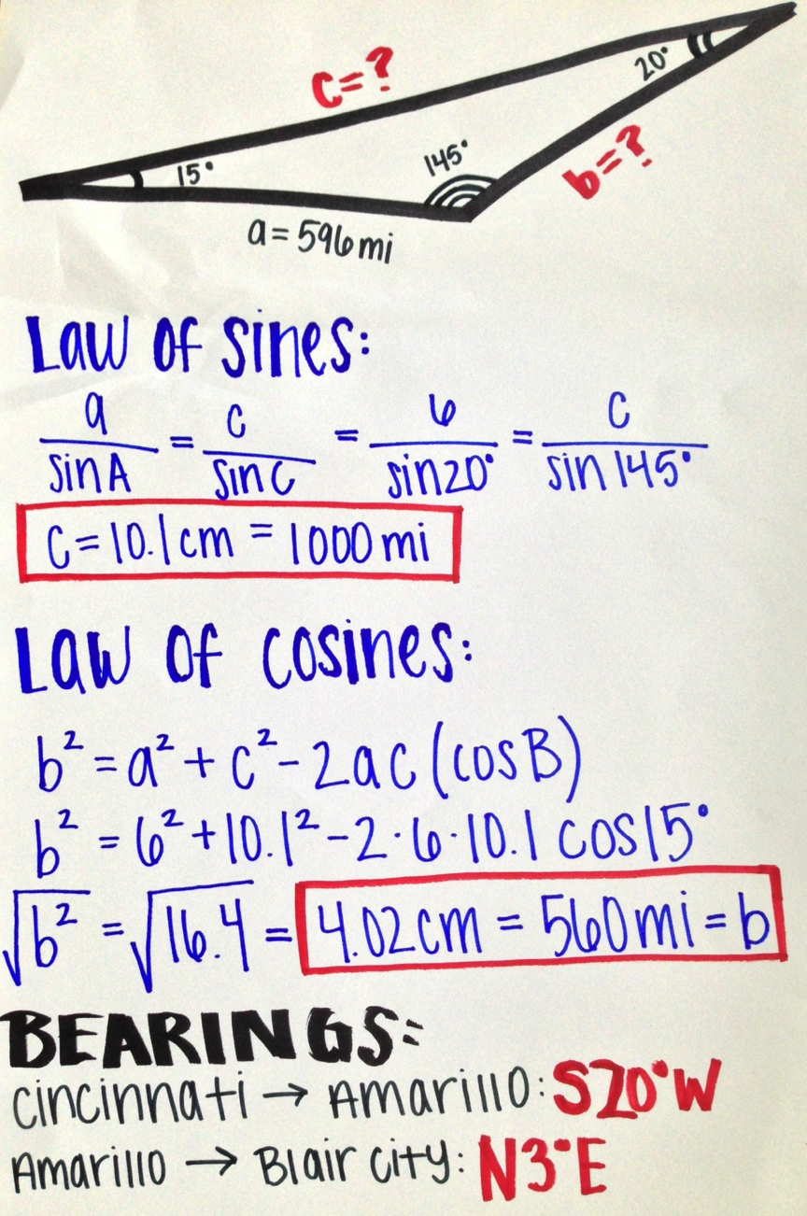
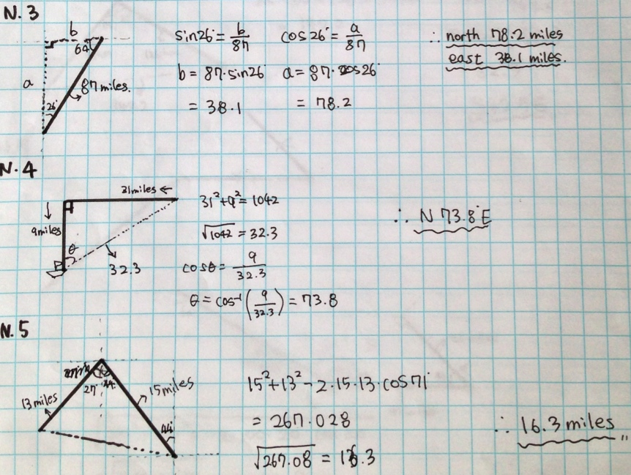
Disaster Relief Planning Carlo Miraldi Fairfield Senior High School, Math
RET is funded by the National Science Foundation, grant # EEC 0808696.
Assessment Results:
Impact on Student Learning

Slide 6
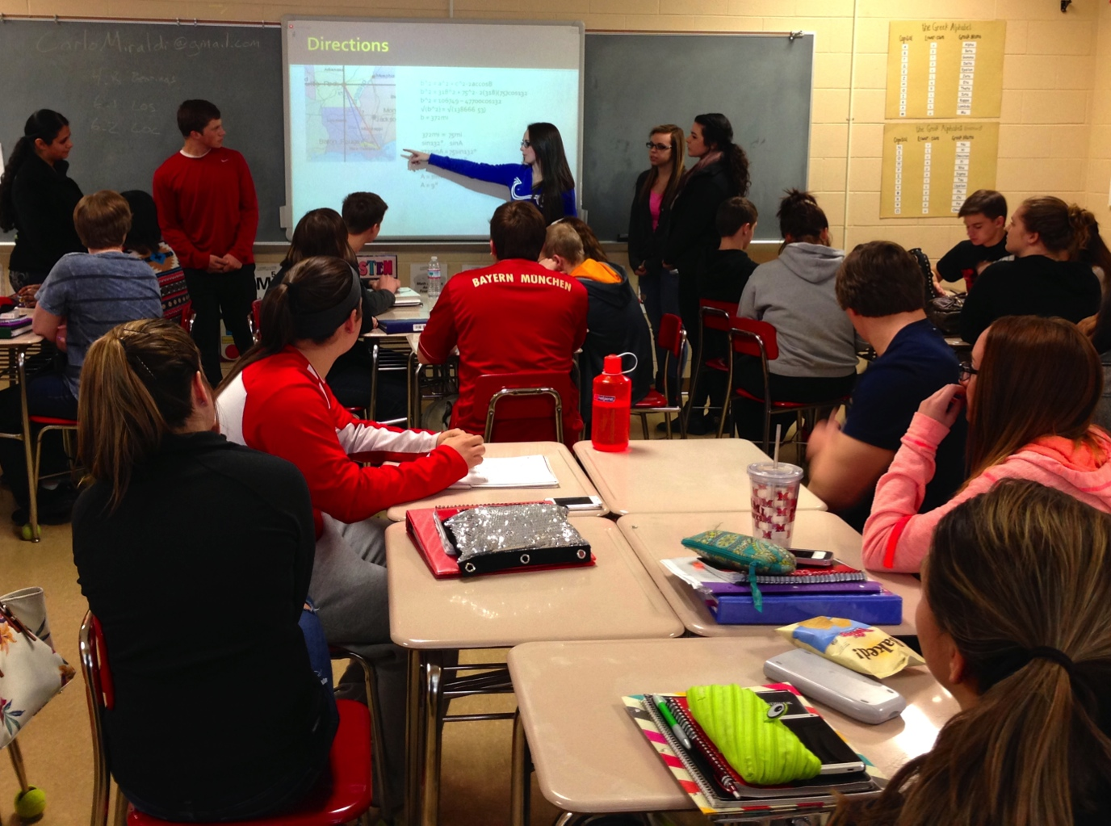
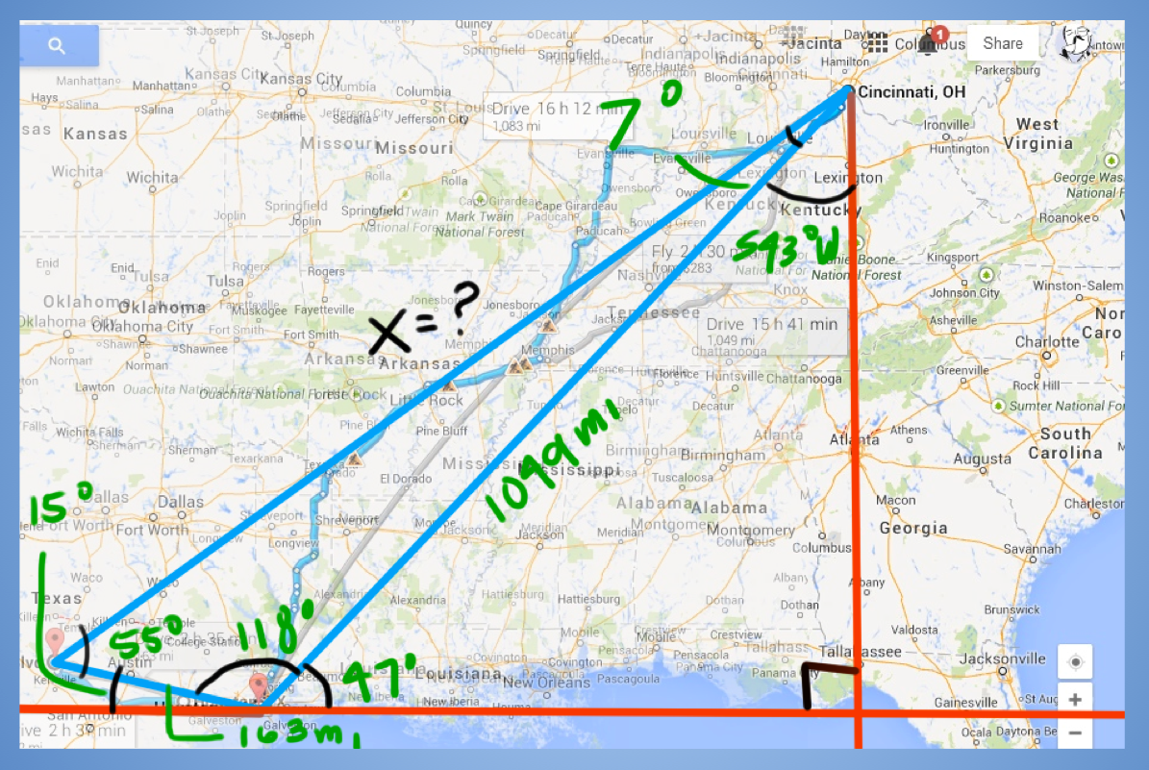
Disaster Relief Planning Carlo Miraldi Fairfield Senior High School, Math
RET is funded by the National Science Foundation, grant # EEC 0808696.
Unit Activity Implementation
Lesson 1 Understanding Disaster Relief
Activity #1 Essential Question
-Show introductory videos
-Lead Essential Question Discussion
Activity #2 Learn Necessary Skills
-Bearings (accurate navigational directions)
-Law of Sines (missing distances)
-Law of Cosines (missing distances)
Lesson 2 Designing a Disaster Relief Plan
Activity #3 Test Necessary Skills
-Create Amazing Race style clue cards using bearings, Law of Sines, and/or Law of Cosines for a “Search & Rescue Mission” throughout the school
-Follow “Search & Rescue Mission” clue card from another group
Activity #4 Design a Plan
-Create detailed Disaster Relief Plan
-Practice presentation to receive feedback
-Refine and present final product

Slide 7
Disaster Relief Planning Carlo Miraldi Fairfield Senior High School, Math
RET is funded by the National Science Foundation, grant # EEC 0808696.
Reflection & Conclusion
-This Disaster Relief Unit went very well in Precalculus
-Nearly all students were hooked and had true buy in during the entire process.
-It took much longer than expected, but was well worth it.
-Next time I will need to remind students what the test questions will look like throughout the process and not just during the pre-test, activity #2 worksheets, and post-test.

